Slide 1

Welcome to Poly Parent Morning

Slide 2
Keeping your child safe online
Check their phone regularly – you should know the passcode
Talk about the content and ask questions.
What groups are they in? What apps do they use?
Check out the CEOP (Child Exploitation and Online Protection) Command website. It has lots of resources and advice.
The NSPCC website also has lots of useful resources.

Slide 3
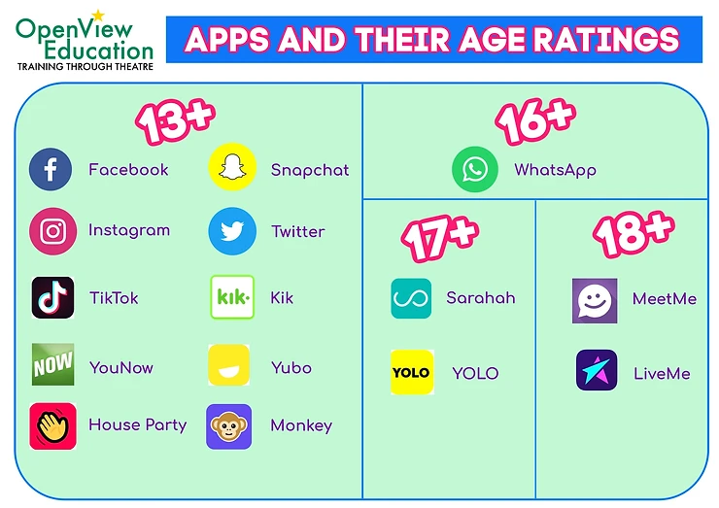

Slide 4
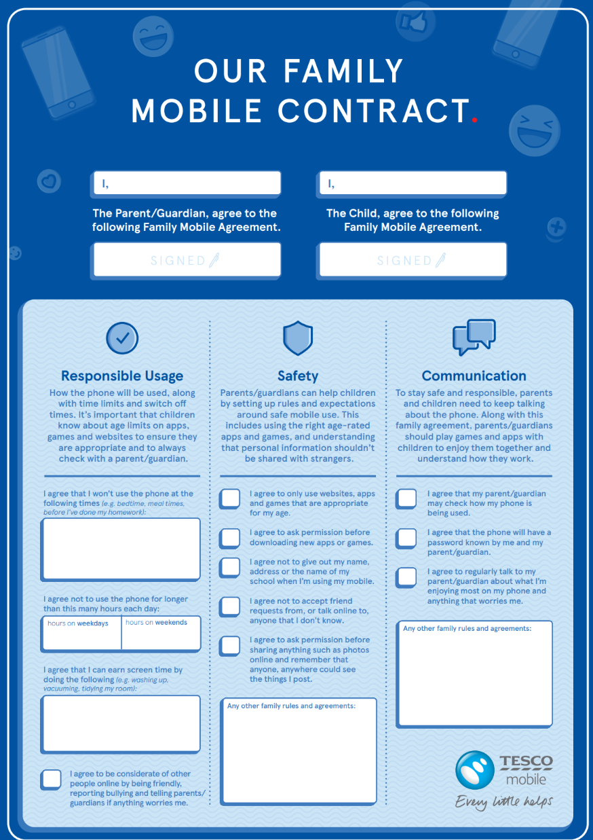
Further recommendations
Open dialogue
Mutual respect
Family agreement to outline expectations
Have clear expectations around time - especially bedtime!
Remind them about phones in school

